Slide 1
Statistical Learning and data Mining
Assignment 3
Gaurav Gavali – 22060641065

Slide 2

Ebay Auction Case Study
ebay, the world’s foremost leading online auction site has become a major
online seller over the Internet. eBay was founded by Pierre Omidyar in
September 1995 inside his living room in San Jose. At the time, it was meant to
be a small personal site to sell used items utilizing a simple ascending bidding
system. Little did Omidyar know that his system of online auctioning would
revolutionize the world by blending in the convention of auctions with the
technology of the Internet to increase the efficiency of day to day “sales.”
Over eighty million people visit eBay.com with over two hundred million
individual auctions. This combination generates over four billion dollars in
transactions each year, representing an unprecedented amount of economic
activity online through auctions.
Since online auctions is still a relatively new concept, extensive studies and
theories have not been conjectured until recently. Due to this limitation, eBay
consumers had to rely on logic, and trial and errors in the first years of eBay. G
Instead of strict prices and amounts that dictate the consumer attitude toward
purchasing, the procedure of buying and selling to a selfimposed price brings
about an entirely new way to understand the rationality behind internet sales and
auctions on sites like eBay.
One interesting business problem is to examine if the seller’s “reputation”,
measured by seller’s feedback, has a positive correlation to buyer’s willingness to
bid on an item as well as the price of the item. Furthermore, it is of interest also
look at whether the length of the days the seller puts an item for sale has any
correlation to the final price bidders are willing to pay.

Slide 3
The goal is to use these data to
1. Build a model that will classify auctions as competitive or non-competitive.
2. Identify important attributes leading to competitive auction
3. Suggest actionable recommendations to the manager so hat higher rate of competitiveness can be achieved
We will use these data to build a model that will classify auctions as competitive or non-competitive. A competitive auction is defined as an auction with at least two bids placed on the item auctioned. The data include variables that describe the item (auction category), the seller (their eBay rating), and the auction terms that the seller selected (auction duration, opening price, currency, day-of-week of auction close). In addition, we have the price at which the auction closed. The task is to predict whether or not the auction will be competitive.

Slide 4
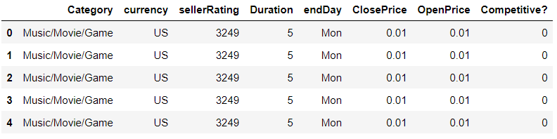
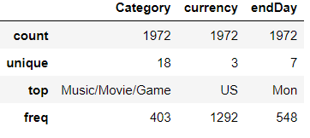
About Dataset
Data set consists of total 1972 observations with 12 Features
EDA: Descriptive statistics for numerical and categorical features

Slide 5
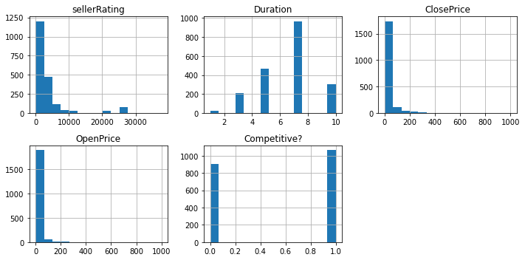
Visualizations
Histograms for numerical features

Slide 6
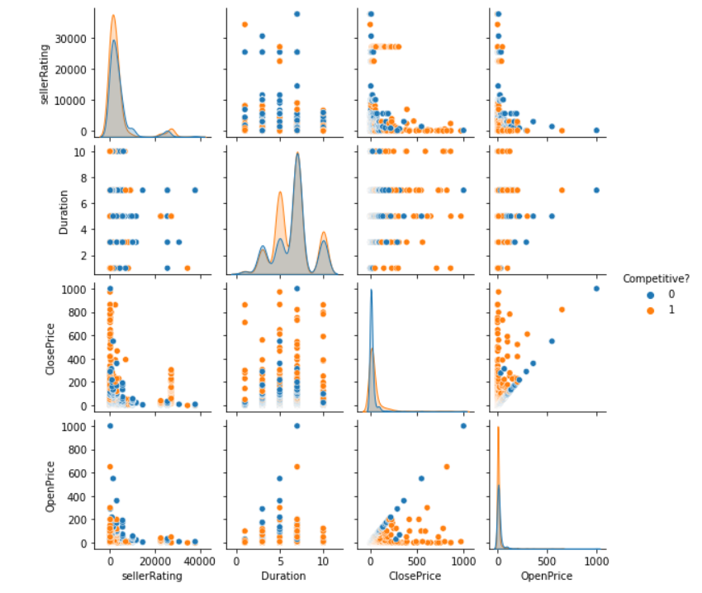
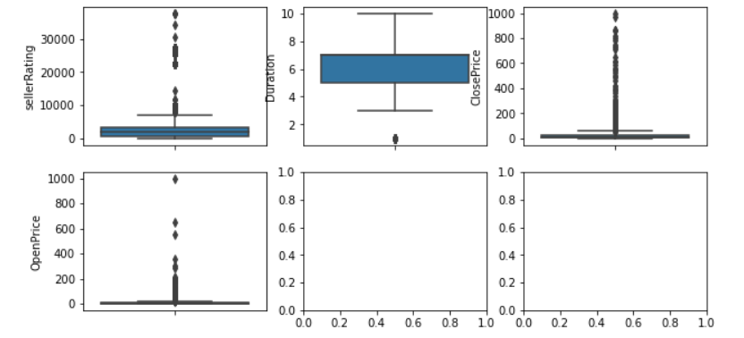
Visualizations
Pairplots for numerical features
Boxplots for numerical features

Slide 7
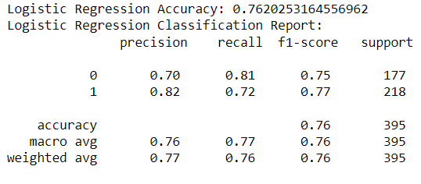
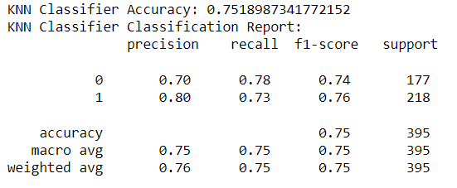
Model Evaluation
Logistic Regression
KNN Classifier
Based on the comparison of the two models, we can conclude that Logistic Regression, with an accuracy of 76%, is a better fit than the KNN Classifier, which achieved an accuracy of 75%.

Slide 8
Actionable Recommendations:
The Logistic Regression model highlights the significance of the opening price on auction competitiveness. Encourage sellers to set competitive opening prices to attract more bidders. Providing sellers with insights into market trends and the importance of attractive starting bids can help improve competitiveness.
The day of the week when auctions close has some impact on competitiveness, according to both models. Analyze historical data to identify days that attract more bidders and consider offering promotions or incentives for sellers to schedule auctions on these favorable days
Develop and provide tools or guidance for sellers to optimize their auction strategies. Encourage sellers to actively monitor their listings and make adjustments during the auction based on bidder activity, which can lead to more competitive outcomes.
While not as influential as opening prices and auction durations, the seller's eBay rating moderately affects competitiveness. Encourage sellers to maintain high ratings through exceptional customer service and a positive trading history.
Although the effect of currency and category is relatively weak, it should not be ignored. Provide sellers with data-driven insights about the most competitive currency and category combinations to support more informed listing decisions.

